Slide 1
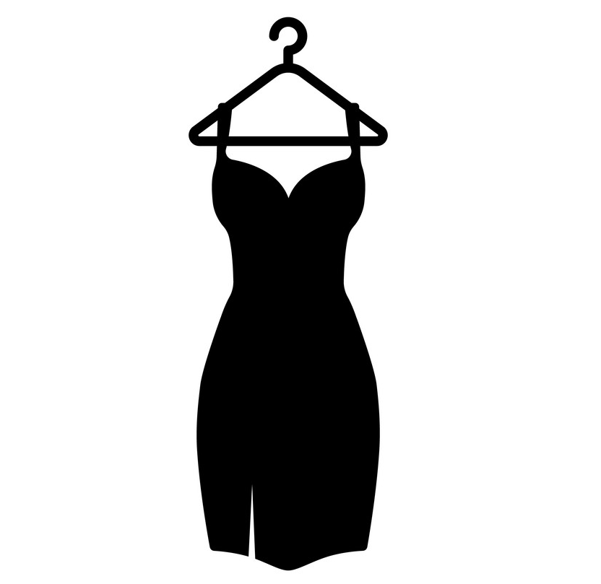
BEYOND (fashion styling website)

Slide 2
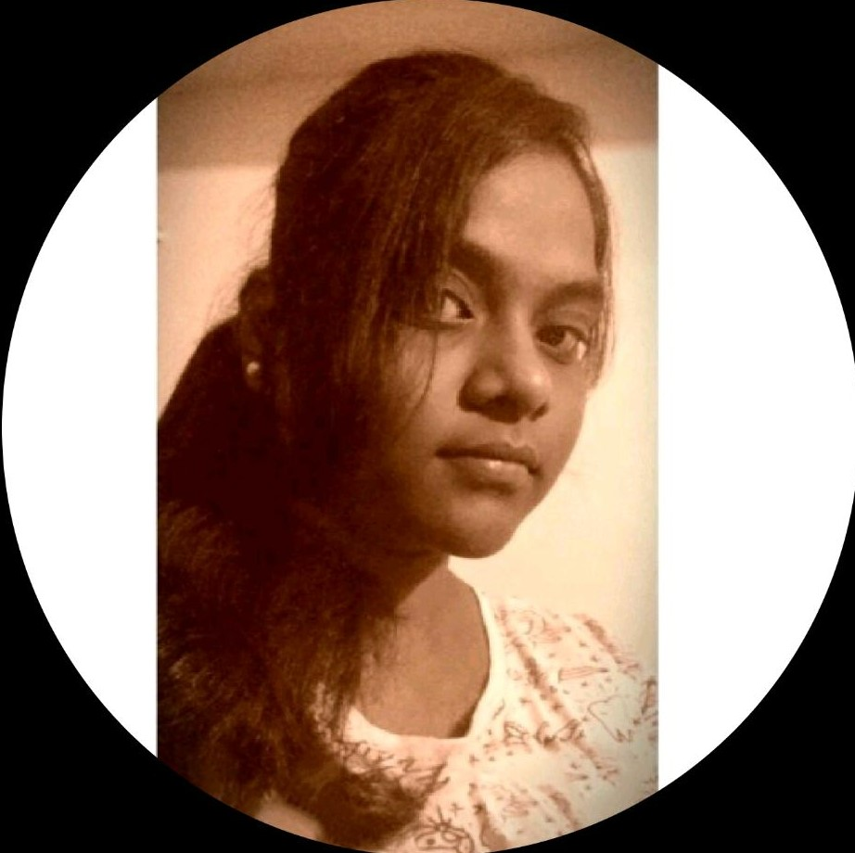
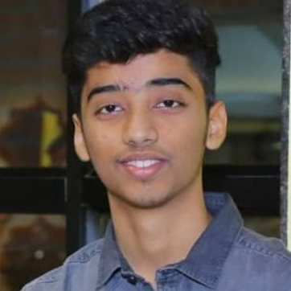
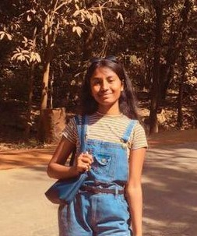
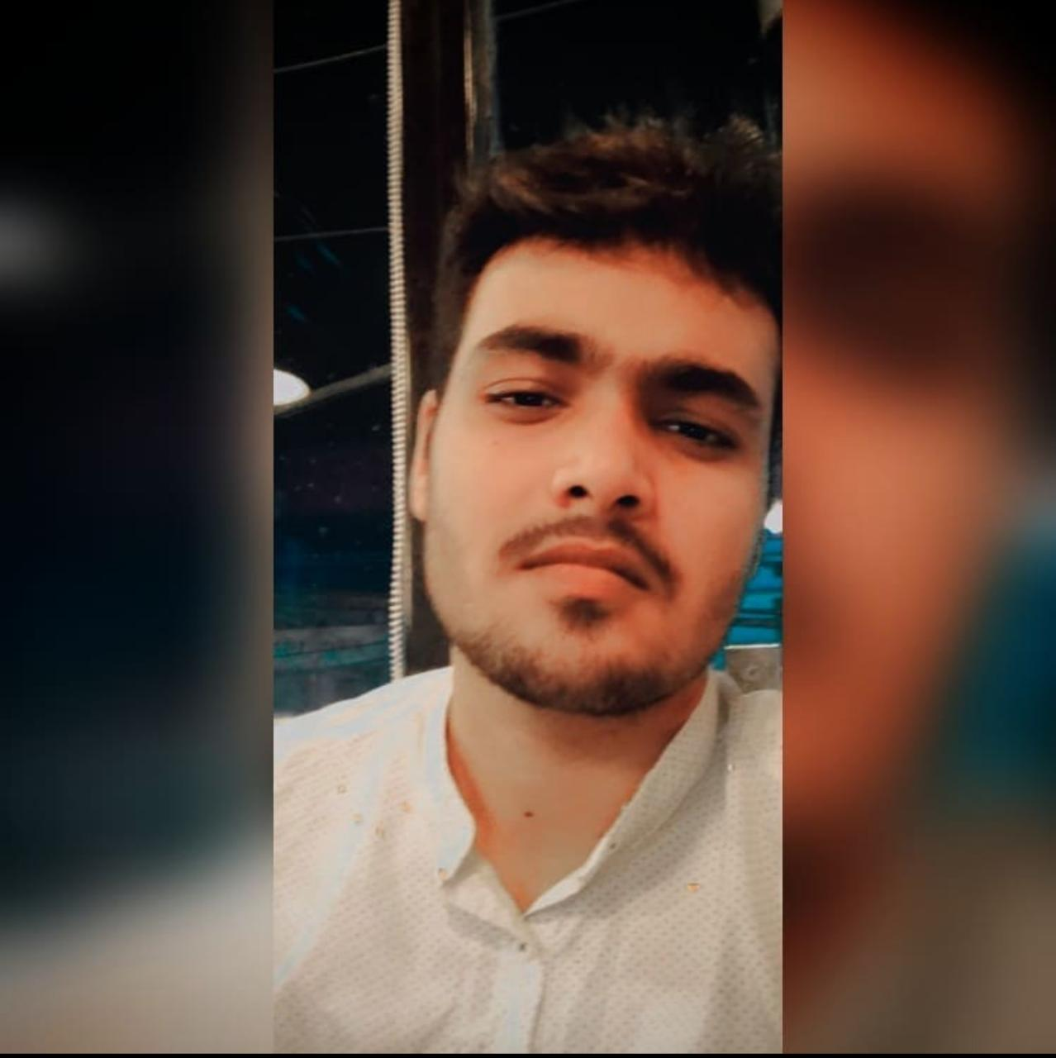
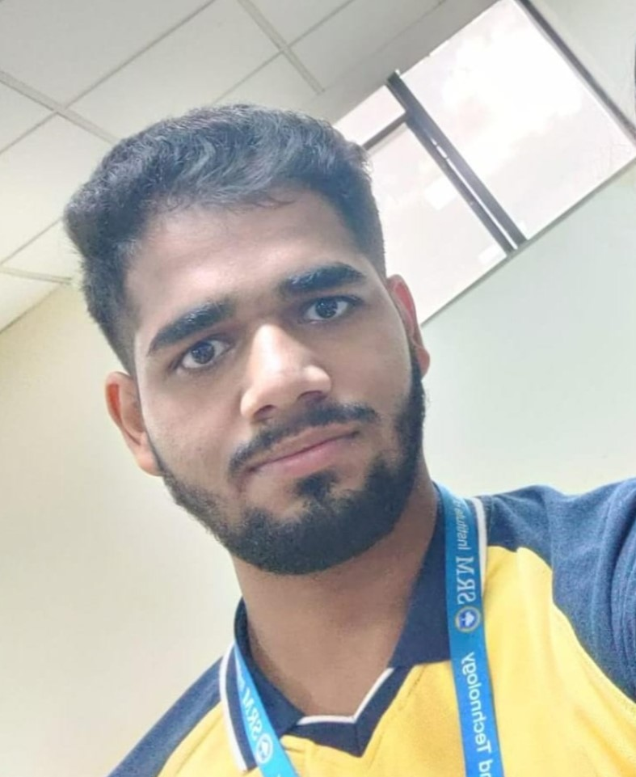
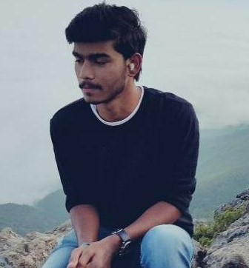
Team Members
VASA CHANDANA
RA2011047010080
AAYUSH SAXENA
RA2011047010126
ANVITA BANDARU
RA2011047010107
DEVANSH JAISWAL
RA2011047010133
YESHWANTH VENAKATA PADALA RA2011047010131
BHAVYA YADAV
RA2011047010149

Slide 3
PROBLEM STATEMENT
In the era of fast moving fashion, many people don’t know what suits them and what not , how to put outfits together, what to buy, and unaware of what to wear even if they have a closet full of clothes. Therefore, here we come up with a fashion styling website which solves all these mentioned problems.

Slide 4
ABSTRACT
The after-effects of the Covid-19 pandemic have compelled everyone to take their businesses online. People no longer prefer visiting a market or mall for shopping, rather they prefer searching or browsing online through the internet for shopping and inspirations for new arrivals & accessories. This also helps them save their time & effort.
The Online fashion styling website project proposed here will automate the process of online styling for the users by providing a customer-friendly experience. This system will connect the users & the fashion stylists. The users can view the stylists’ profiles. The users can view the available stylists and can request for chat. Based on the inputs received from the user, the stylist will recommend products and accessories that will suit the user’s interest & personality. Both the users & stylists can access the system by registering themselves on the website.
This project is completely based on current fashion trend and styling. This website provides client with their customized product according to their style and personality. These days getting a product is lot more easily than styling it and presenting to the outer world in trendy way so, our website brings all such conditions under one roof and brings the best out of people. This will be a huge benefit to all the busy personalities out there in their styling. This system comprises of chat box so that users can chat with stylish so that user can describe exact requirements of the attire the user need

Slide 5
PROJECT DESCRIPTION
This website consists of 7 sections in the whole which are listed below:
-Home
The user can see all the recommended products(full outfits, tops, bottoms and accessories etc ).
in the catalog and able to look at the products and some features, it's sources on the homepage.
-Sign Up
This refers to registering as a new customer/user in case the person didn't had an account before.
The registered member has a lot of privileges associated with the website when one becomes a customer.
-Sign In
After the user has registered, the user becomes a customer, and he or she can log in with
their personal

Slide 6
PROJECT DESCRIPTION
-Profile
This section of the website is a web page accessible to the public or to guests,
which provides personal information about the entity that created the beyond account.
-Favourites
This refers to show all of the recommended products(full outfits, tops, bottoms and accessories etc)
you have favorited, as well as people you may have favorited through this website.
-Chat Bot
This refers to a Chat Bot which is specially designed to complete buyers’ purchases,
offer buyers product recommendations and to provide customer support.
-Search Bar
This refers to the search bar on the site that can influence the user's decision to make use of it
to look for products and for clear navigation of the entire site.
This is so that visitors can move around easily, whichever page they happen to arrive at.

Slide 7
WHICH MODEL IS SELECTED?
Prototyping model
Prototyping is defined as the process of developing a working replication of a product or system that has to be engineered. It offers a small scale facsimile of the end product and is used for obtaining customer feedback
Extreme Prototyping
This method is mainly used for web development. It is consists of three sequential independent phases:
In this phase a basic prototype with all the existing static pages are presented in the HTML format.
In the 2nd phase, Functional screens are made with a simulate data process using a prototype services layer.
This is the final step where all the services are implemented and associated with the final prototype.

Slide 8
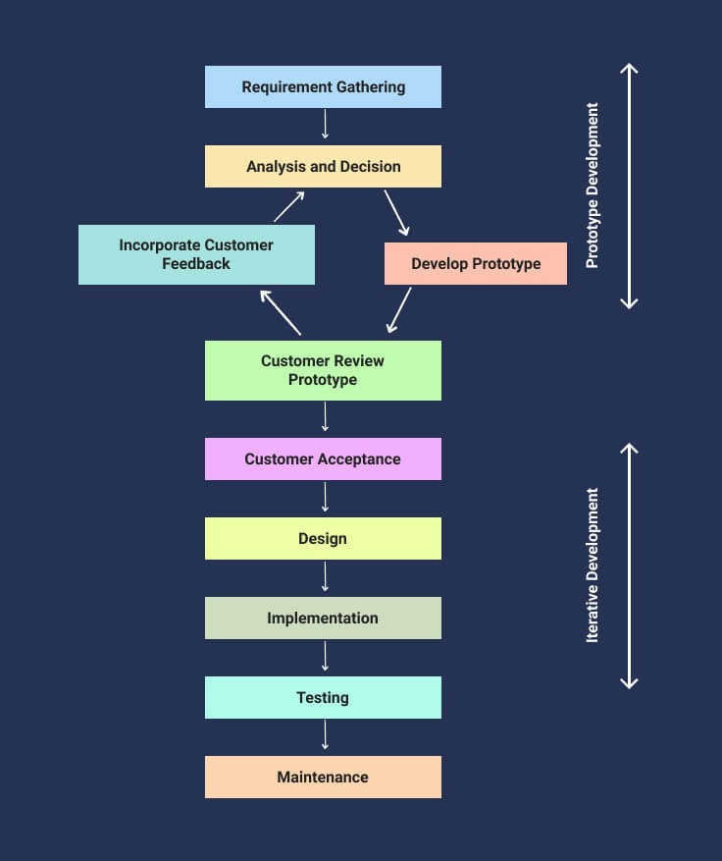
WHY THIS MODEL?
This Extreme Prototyping method makes the project cycling and delivery robust and fast, and keeps the entire developer team focus centralized on products deliveries rather than discovering all possible needs and specifications and adding unnecessitated features.
New requirements can be easily accommodated as there is scope for refinement.
Errors can be detected much earlier thereby saving a lot of effort and cost.
.

Slide 9
Thank you !!

